Slide 1
ENEMY BESTIARY
By Lamarr redhead-davis

Slide 2
INTRODUCTION – LAMARR REDHEAD-DAVIS
APPROACH
Did some research into one table entities.
Found that stats of thing such as league tables, personal libraries and records from IMDB in particular would model well for this project,
Mapped that to knowledge on video games and RPG games especially
Opted for an enemy bestiary (fun!)

Slide 3
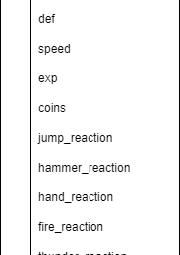
CONCEPT
As I’m familiar with RPGs and their different listed statistics for entities, I based my project on the Mario & Luigi series.

Slide 4
SPRINT PLAN
Homepage: Displays details of the website
Catalogue: Table showing minimal details where user could manipulate
Profile: Displays all details of enemy in a clean readable format

Slide 5
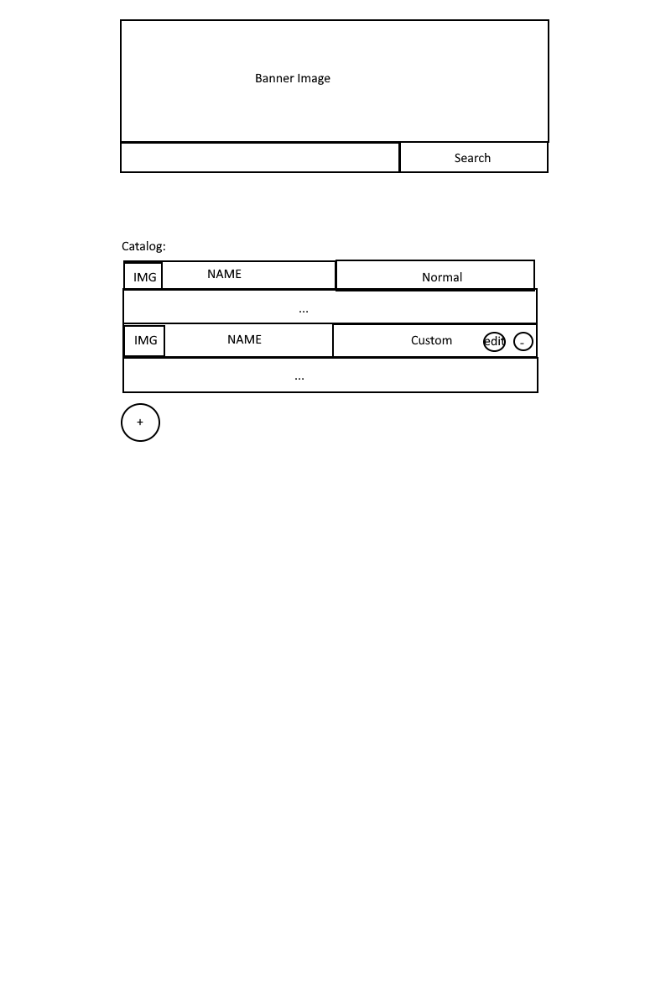
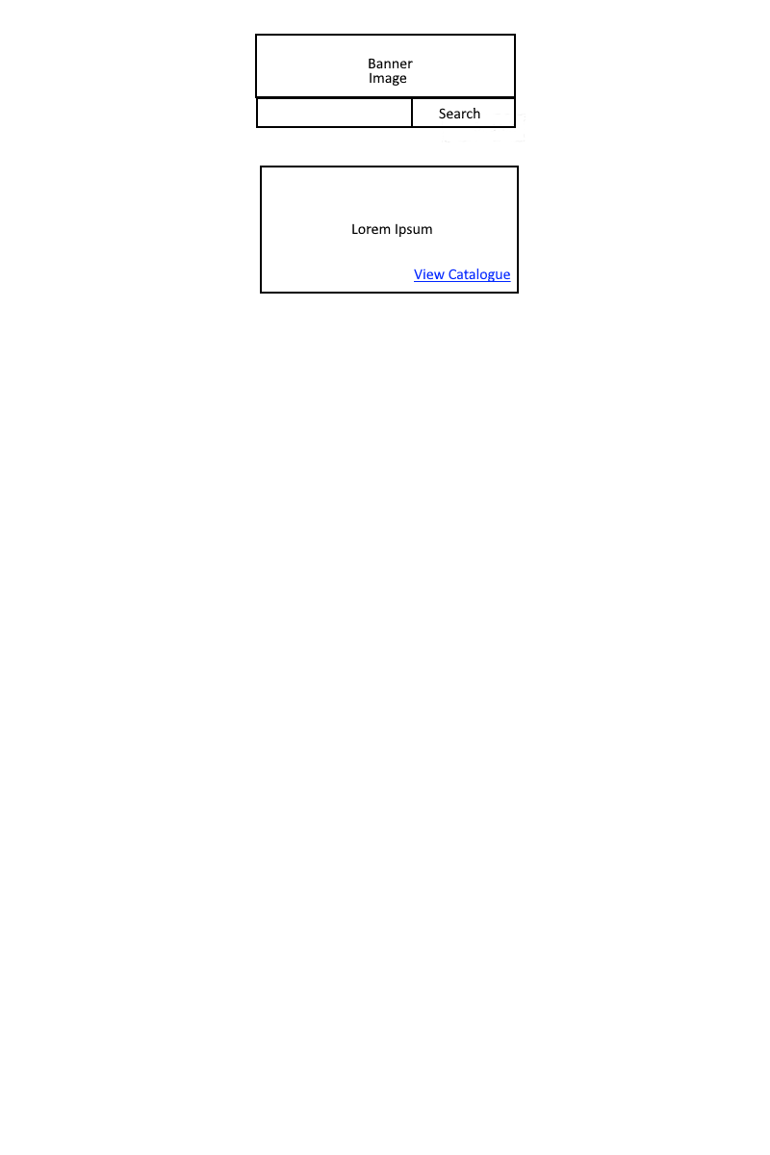
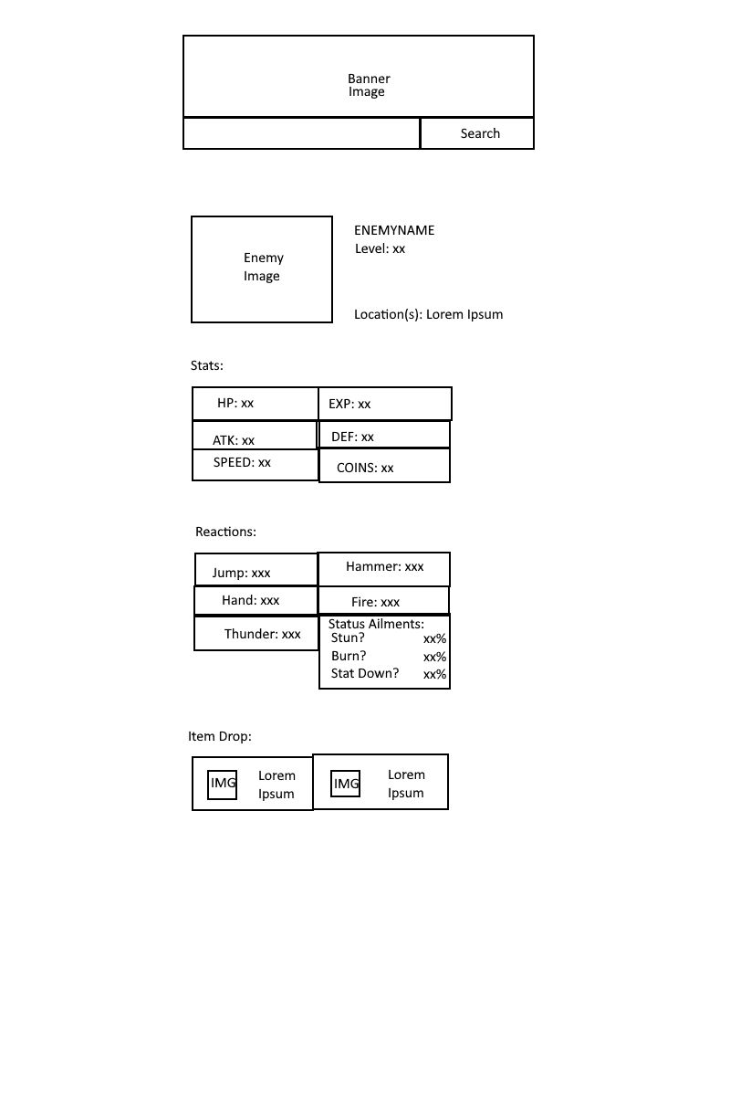
Catalogue
Homepage
Profile

Slide 6
JOURNEY
HTML – Handles structure of web content
CSS – Handles design of web content
JavaScript – Handles computations regarding interacting with web content
Spring Boot – Handles functionality between SQL and the frontend (website) and models 3-tier architecture (Data <-> Business Logic <-> Presentation)

Slide 7
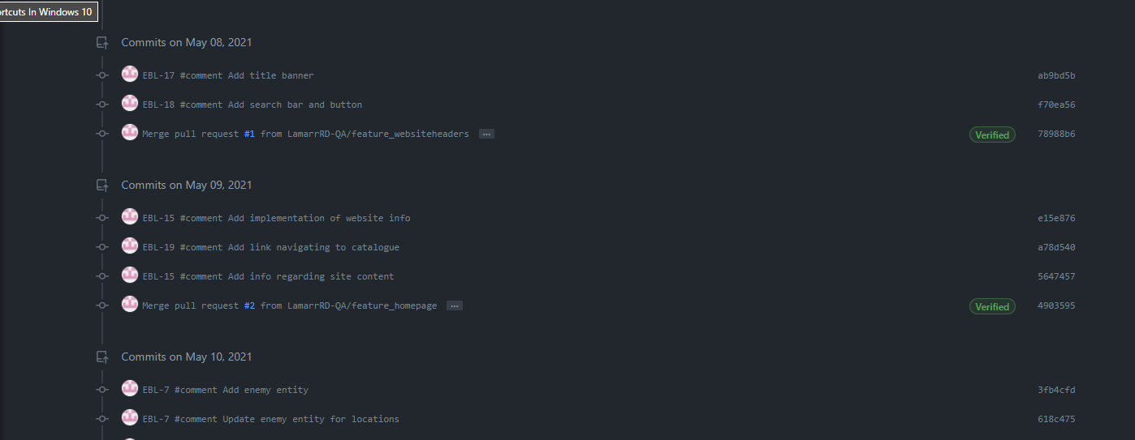
CI
Commits pushed up to GitHub which uses Git as a version control system

Slide 8
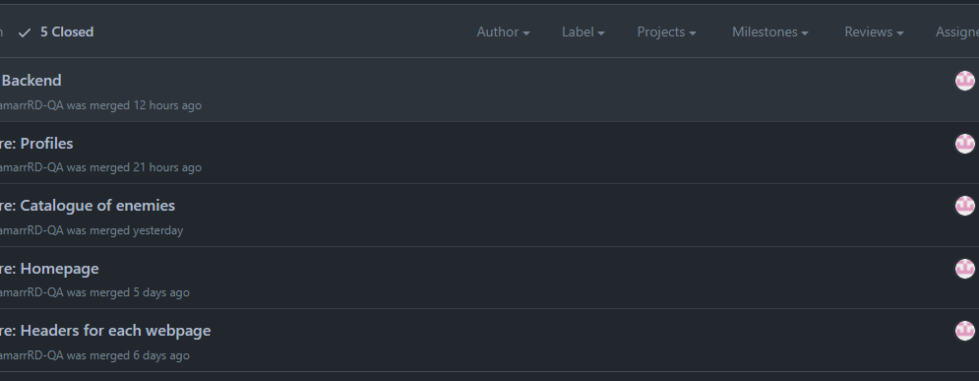
CI
Pull requests to merge feature branches into dev and later into main

Slide 9
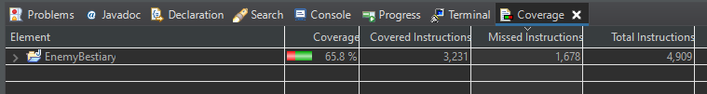
TESTING
Selenium and JUnit4 for frontend testing
Spring Test (Mockito and Junit5 as helpers) for backend testing
Coverage achieved: %

Slide 10
REVIEW
COMPLETED
ERD
Basic implementation of a functional site (Javascript, HTML, Bootstrap, Axios)
Spring Unit Tests
Spring Backend (transferring data from website to SQL database)
UNFINISHED
CSS refactoring
Uploading image for new enemy
Selenium Testing (handling CRUD cases)
Static Analysis

Slide 11
RETROSPECTIVE
WHAT WENT WELL
Processed the project management a bit more efficiently – research -> plan -> implementation -> tests
Implementation of the backend due to some experience from last project
WHAT COULD BE BETTER
Managing execution of Selenium Tests that handle dynamic content
Entity class could make use of the builder pattern or splitting tables linked by an ID.
Overall, simplifying the scope of what needs to be achieved to reach the MVP with testing incorporated

Slide 12
CONCLUSION
REFLECTIONS
Javascript, Java, CSS and HTML follow some very different rules on implementing functions so easy to run into issues whilst managing the different codesets
Appreciation of the value of testing and refactoring (no matter how miniscule or large)
FUTURE STEPS
Write out a list of steps needed to reach MVP and plan accordingly
Write basic version of project (pseudocode) whilst researching tools used to create project

Slide 13
ANY QUESTIONS?
THANK YOU!

